Slide 1

Surface (100)

Slide 2
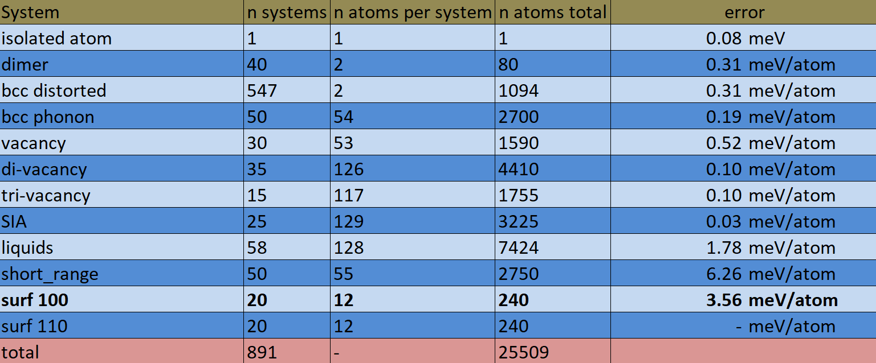
Surface (100)

Slide 3
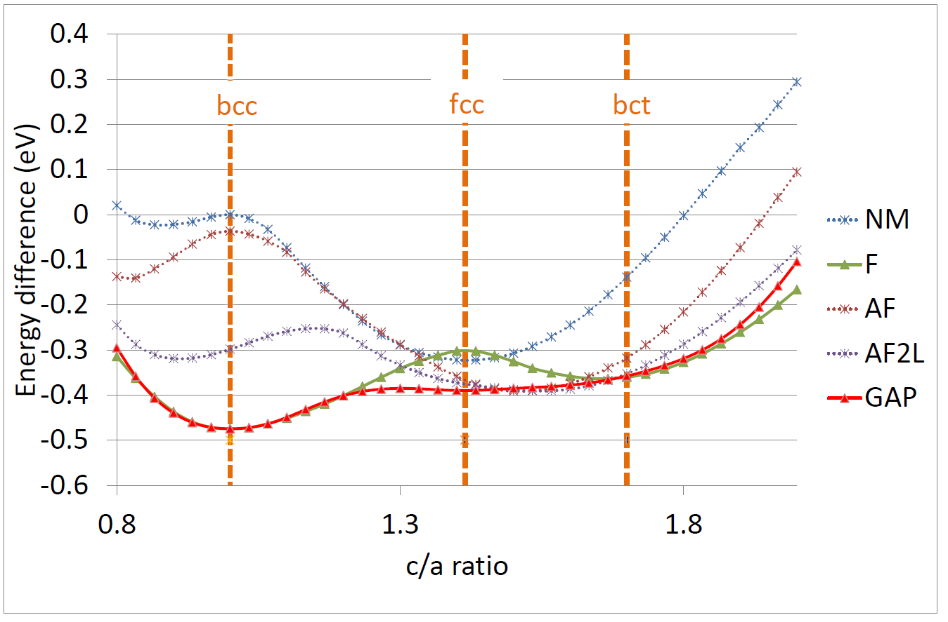
Bain path

